Slide 1
6G4Z0024 Web Development Lecture 1: Introduction to Web Development
Ashley Williams
ashley.williams@mmu.ac.uk

Slide 2
Learning Objectives
To understand the structure for the rest of the unit
To understand the history of web development
To understand the fundamentals of how the web works
To experience and understand the basics of HTML and what HTML is

Slide 3
Who am I?
Ashley Williams
Lecturer in Software Engineering
Previously worked in industry as an analyst before moving to New Zealand to undertake my PhD
Unit leader for:
Web Development (year 1)
Full Stack Development (year 2)
Mobile Computing (year 3)

Slide 4
Who am I?
Research Interests:
Credibility assessment, evidence based software engineering, NLP/text mining, grey literature, SE education
Teaching Interests:
Web/mobile application development
Software engineering process and people
Personal tutoring

Slide 5



Meet the team
Lab Tutors
Jin Yee Tay
J.Tay@mmu.ac.uk
Yanlong Zhang
Y.Zhang@mmu.ac.uk
Lab Support
Branden McAuley

Slide 6
Who are you?
First year students:
All have Programming 1 and 2
Previous web experience? (Lots?, some?, none?)
Software Engineering?, Computer Science?, Forensics?, Cyber?
Considering a placement year?
Thinking about future careers (web dev?)

Slide 7
Why are we here?
To gain an understand of web fundamentals (e.g. what the web is, how it works)
To gain a basic understanding of the technologies/languages that are used for web development
To start thinking about what we want to do after University, start exploring different areas of industry, find what parts of SE interest us the most

Slide 8
Unit Objectives
Learning Outcome 1: Create basic web pages using HTML to mark-up content, using CSS to control its presentation in web browsers
Learning Outcome 2: Write efficient and readable client-side scripts that are event- and object-driven and runs on multiple browsers and platform
Learning Outcome 3: Apply web design usability principles in the creation of web content based on the requirements of a given scenario

Slide 9
Unit Information
Web Development – 6G4Z0024 (15 Credits)
Unit Leader: Ashley Williams (Ashley.Williams@mmu.ac.uk)
6 weeks long with the 7th week for the assessment hand-in
1 coursework based assessment worth 100% of the unit (1CWK100)
Deadline: Friday 10th March @ 2100

Slide 10
Assessment Overview
Is available now on Moodle, but I will discuss it later on in the Unit once we have covered some of the topics
You will be asked to create a website for your favourite musician/band. You will need to meet some technical requirements to showcase your web development skills
You will be assessed on your understanding of the technologies covered throughout the Unit

Slide 11
Unit Structure
# | W/C | Lecture | Lab
1 | 24/1/22 | Intro to the Unit; History; How the web works; Intro to HTML | Basic HTML
2 | 31/1/22 | HTML Forms; Intro to CSS | HTML Forms; Basic CSS
3 | 7/2/22 | Layouts with HTML and CSS; Responsiveness; Intro to JS | CSS Layouts; Basic JS
4 | 14/2/22 | JS for performing basic tasks | Working with JS
5 | 21/2/22 | REST APIs; Dynamic pages with JS | Sending/Receiving HTTP requests with JS
6 | 28/2/22 | Assignment; Next Steps | Assignment Support

Slide 12
Week Overview
Attend the lecture
Attend the lab
Complete the practical worksheet
Moodle: https://moodle.mmu.ac.uk/course/view.php?id=134105

Slide 13
This course in context
Software Engineering module – you will write code
The first time you are working with web technologies – an opportunity for you to dip your toes
The unit teaches web development fundamentals, but…
Allows you to play around with technologies that are vital in industry
Tries to mimic an industry type project – could be used as a portfolio piece
Strengthens your ability to code well

Slide 14
Support and Feedback
Please first try to get support through the scheduled sessions – labs, lectures
Outside of these sessions, the best way to contact me is via Teams or email – Ashley.williams@mmu.ac.uk
I will respond to your emails, ideally within 1 working day but in some cases this may take a little longer (no more than 3 working days).
If you have not heard from me after three days, please chase up.
Office location: JD E120 (please only by appointment, or during office hours)

Slide 15
Questions?

Slide 16
What is the difference between the internet and the web?

Slide 17
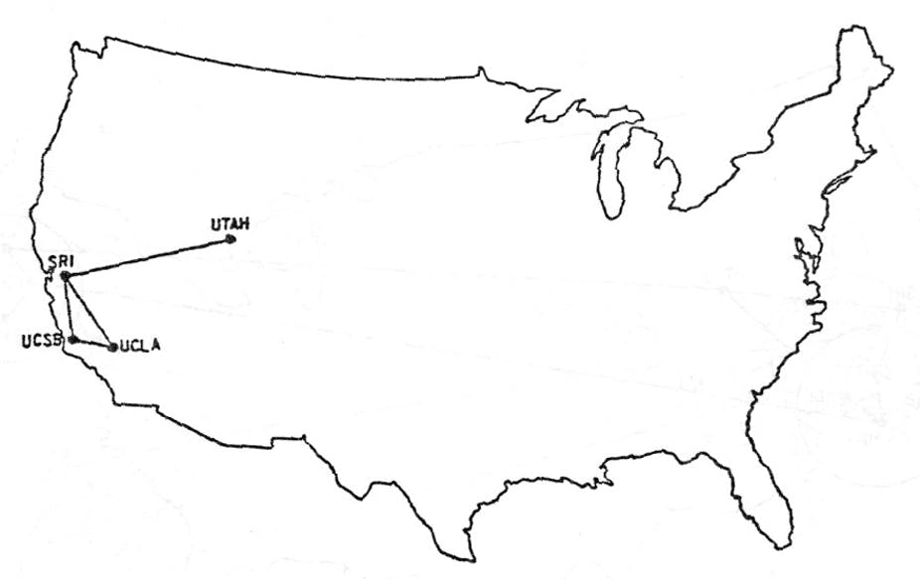
Who remembers this from week one of Graduate Skills?

Slide 18
Who remembers this from week one of Graduate Skills?
ARPANET (December 1969)
Connected four nuclear research facilities to allow for shared processing
Testing environment to explore the possibility of building a network without enforcing standardization
Formed the basis of the internet and core communication protocols (TCP/IP)

Slide 19
Internet
Is just a mess…
A network of networks
When you connect a device, or a router, you add to the mess
But, it also contains communication protocols for communicating and navigating traffic around the mess

Slide 20
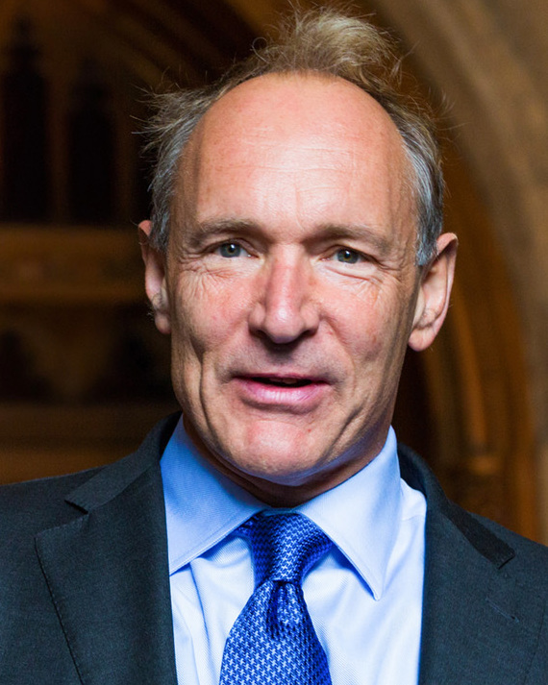
The Web
Invented by Tim Berners-Lee in 1989
Software Engineer at CERN
“In those days, there was different information on different computers, but you had to log on to different computers to get at it. Also, sometimes you had to learn a different program on each computer. Often it was just easier to go and ask people when they were having coffee…”

Slide 21
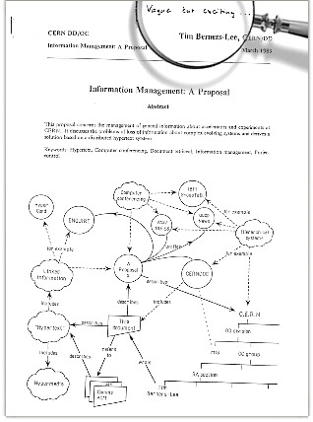
The web
Computers were already being connected through the internet, Berners-Lee saw an opportunity for sharing information across networks using a technology called hypertext
Initial proposal was not immediately accepted, with his boss writing “Vague but exciting” on the front page
Regardless, his boss managed to give him time to work on it

Slide 22
The web
By October 1990, Berners-Lee had written three fundamental technologies that remain the foundation of the web today:
HTML: HyperText Markup Language. The formatting language for the web.
URI: Uniform Resource Identifier. A kind of “address” that is unique and used to identify each resource on the web.
HTTP: Hypertext Transfer Protocol. Allows for the retrieval of linked resources across the web.

Slide 23
The web
In addition, he also wrote the first web browser and the first web server
Berners-Lee and others advocated to ensure that CERN would agree to make the underlying code free forever. This was announced in 1993 and sparked a global wave of creativity, collaboration and innovation.
In 2014 (the webs 25th birthday), almost two in five people around the world were using the web.
In 1994, Berners-Lee moved to MIT and founded the World Wide Web Consortium (W3C). An international community committed to developing open web standards.

Slide 24

How does the web work?
The client-server model
The server provides a function or service to one or many clients, which initiate requests for such services
Servers are classified by the services they provide (e.g. Web server, Discord server, File server)
A web server serves web pages to a client
Typically the client is a web browser (e.g. Chrome, Firefox)

Slide 25
How does the web work?
We will cover this in more detail in week 5
GET /about-us HTTP1.1
Client
Server
200 OK HTTP1.1
<html>
….
</html>

Slide 26
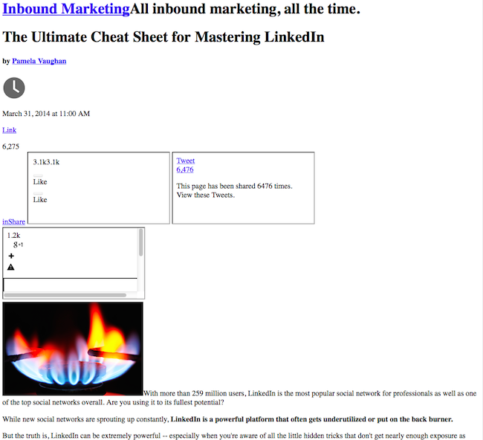
HTML (HyperText Markup Language)
The formatting language for the web
The structure of a web page
Includes all of the content, but no styling
How many of you have seen websites that look like this?
Normally fixed by refreshing, why is that?

Slide 27
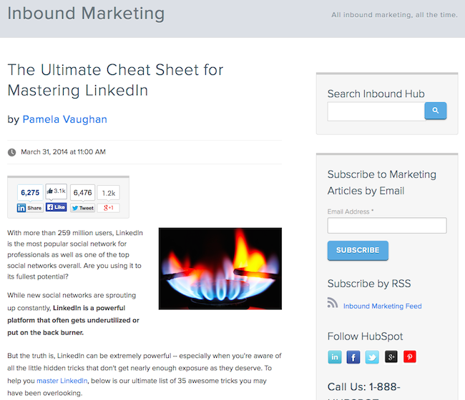
CSS (Cascading Style Sheets)
Because the style rules are stored in a separate file, the client has successfully retrieved the HTML from the server, but not the CSS file
More about CSS next week…
This week we will focus on HTML

Slide 28
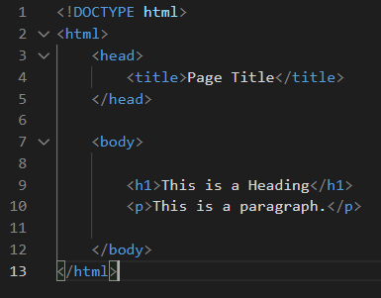
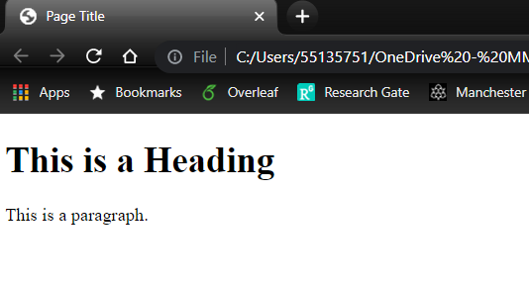
HTML Basics
We write HTML, then the browser can parse the HTML in a graphically pleasing way
The HTML standard tells browsers how to parse the HTML correctly so that it looks the same across devices

Slide 29

HTML Basics
HTML is made up of HTML elements
Elements are defined by a starting tag, the content, and then a closing tag
The element is everything from the start tag to the closing tag
See the h1 element, the p element
Some elements may contain other elements
See the body element, also head and html

Slide 30
HTML Basics
The <!DOCTYPE html> declaration defines that this document is an HTML5 document
The <html> element is the root element of an HTML page
The <head> element contains meta information about the HTML page
The <title> element specifies a title for the HTML page (which is shown in the browser's title bar or in the page's tab)

Slide 31
HTML Basics
The <body> element defines the document's body, and is a container for all the visible contents, such as headings, paragraphs, images, hyperlinks, tables, lists, etc.
The <h1> element defines a large heading
The <p> element defines a paragraph

Slide 32
This week's lab
In this week's lab, you will learn the basics of HTML through a series of exercises
There are too many elements to learn, so this lab is designed to equip you with the tools and knowledge to create HTML pages, and research new elements/features yourself
HTML is a fundamental web technology. It is vital that you do this week's lab before we move onto CSS next week.

Slide 33
Questions?

Slide 34
Sources
https://webfoundation.org/about/vision/history-of-the-web/
https://en.wikipedia.org/wiki/Client%E2%80%93server_model
https://blog.hubspot.com/marketing/web-design-html-css-javascript
https://www.w3schools.com/html/

